Slide 1

Comparison of UX: CPRS and Cerner
Office of Human Factors and Ergonomic Brown Bag
Blake Lesselroth, MD MBI FACP UXC
Associate Professor & Vice Chair
Department of Medical Informatics
University of Oklahoma Tulsa School of Community Medicine
Tulsa, Oklahoma, USA

Slide 2
Disclosures
The presenters have nothing to disclose and no conflicts of interest.

Slide 3

Learning Objectives
Explain important paradigm differences between the two platforms
List design and workflow differences for major EHR features
Describe implementation actions important for platform migration

Slide 4

Background: Quadruple Aim Quality
Donabedian model argues that structures and processes are predictive of clinical and system outcomes
Poorly designed workflows affect cost, productivity, and user experience
Patient experience is linked to other dimensions
Notes:
The Institute of Healthcare Improvement and the Institute of Medicine both recognize the importance of patient-centered care in an effort to improve healthcare quality and the patient experience

Slide 5

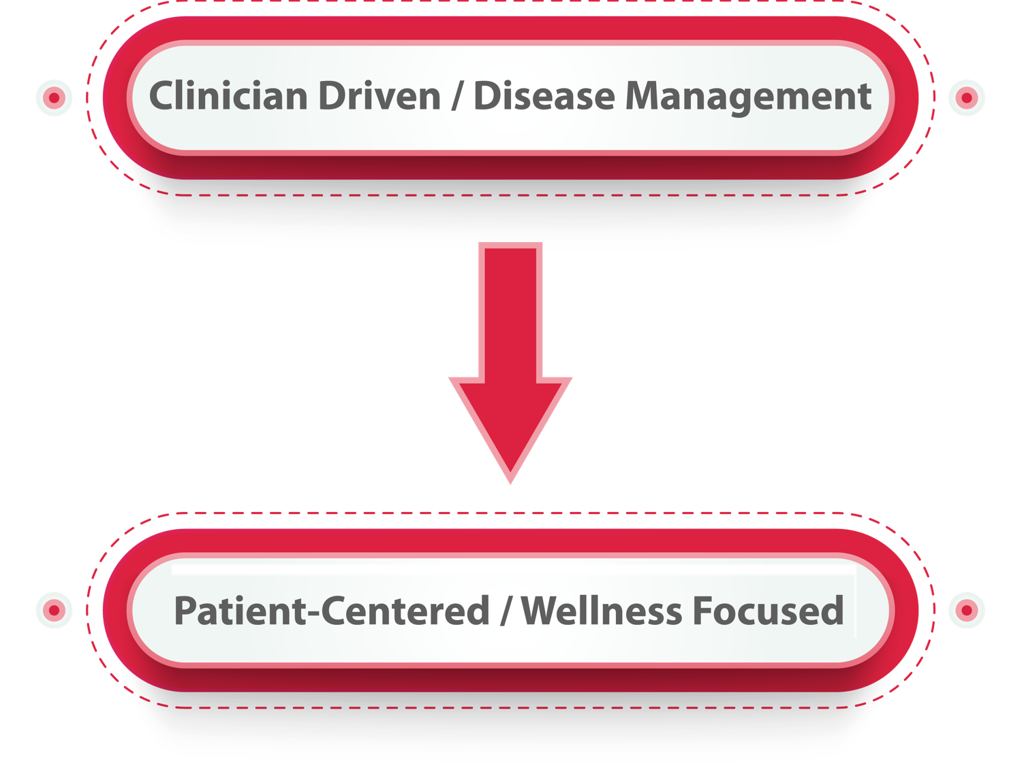
Background: Changing Context
Former Chief of Health Informatics and teaching hospitalist; Portland VA Medical Center, Oregon Health Sciences University
Current Vice-Chair Medical Informatics and Associate Professor of Medicine; University of Oklahoma School of Community Medicine; St. John’s Healthcare System
Notes:
Shift in US and Canadian healthcare from clinician-driven disease management towards wellness and patient-defined outcomes

Slide 6
Background: EHR Components
Institute of Medicine’s vision for electronic health records includes eight core functions: (1) health data archival; (2) result management; (3) order management; (4) decision support; (5) electronic communication; (6) patient support; (7) administrative process and reporting; (8) population health and analytics
AMIA additional key components include: (1) practice management software; (2) managed care modules; (3) referral management; (4) imaging integration; (5) medication tracking; (6) encounter capture; (7) biomedical integration; (8) knowledge resources; (9) preventative health management; (10) data interoperability

Slide 7
Background: EHR Components
VA and Cerner offer a HIMSS level 7 EHR with all these features and capabilities; the implementation approach and relative strengths are decidedly different
Challenging to compare usability between EHRs; little ability to compare of UCD process rigor; variable quality of MU certification vendor attestation¹
No standard set of usability certification tests or tester inclusion criteria; no objective test-based assessments; little standardization in EHR instances
Considerable demonstrated variability of UCD practices between vendors²
Ratwani, JAMIA, 2016
Ratwani, JAMIA, 2015

Slide 8
EHR Paradigms
VistA / CPRS / CDW
Tab and menu driven
Ad-hoc workflows
Template and data object documentation
View alert messaging
Clinical reminders
Embedded coding solutions
Single version
Customizable with large overhead
Cerner Millennium /
Tab and wizard driven
Pre-specified workflows
Template and smart text documentation
Integrated inbox
Powerplans
Bolt-on or built in billing solutions
Multiple versions based on cost
Customizable with large overhead

Slide 9
Features Discussed
List management
Data retrieval and clinical integration
Clinical documentation and automation
Order entry workflow
Labs, microbiology data, imaging, and procedures
Interdepartmental communication
Shift handoffs
Coding and billing

Slide 10
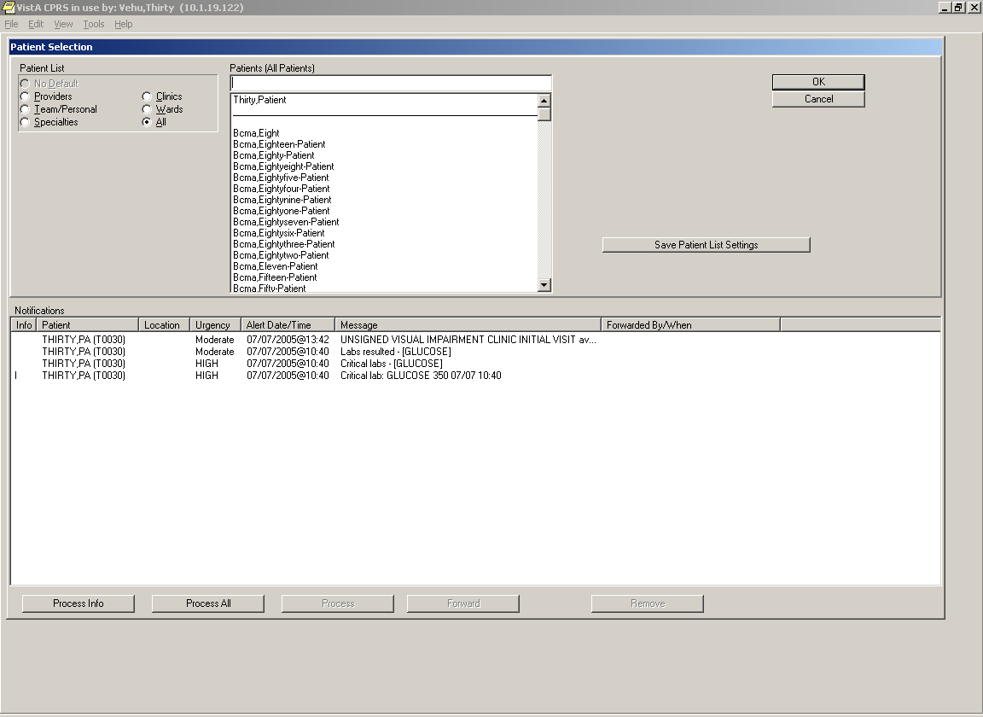
List Management: CPRS

Slide 11
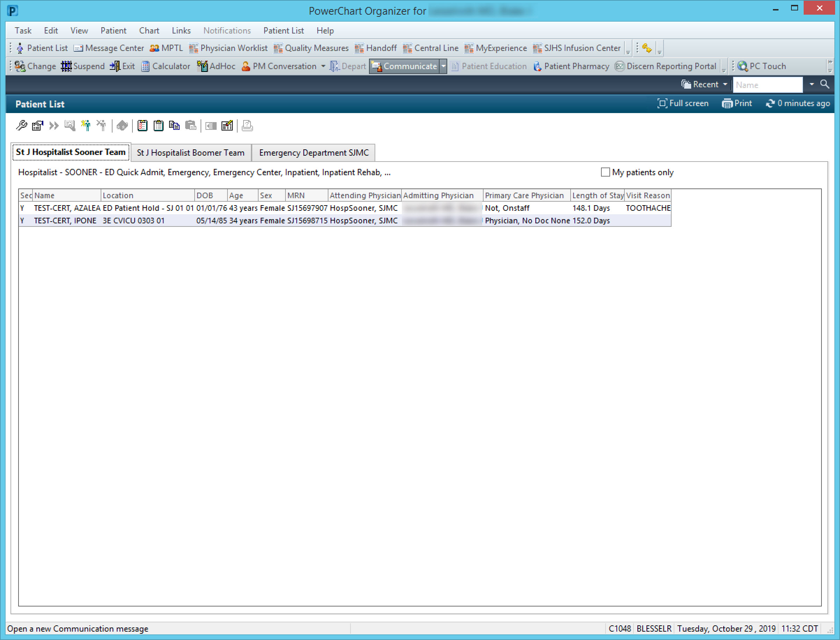
List Management: Cerner

Slide 12
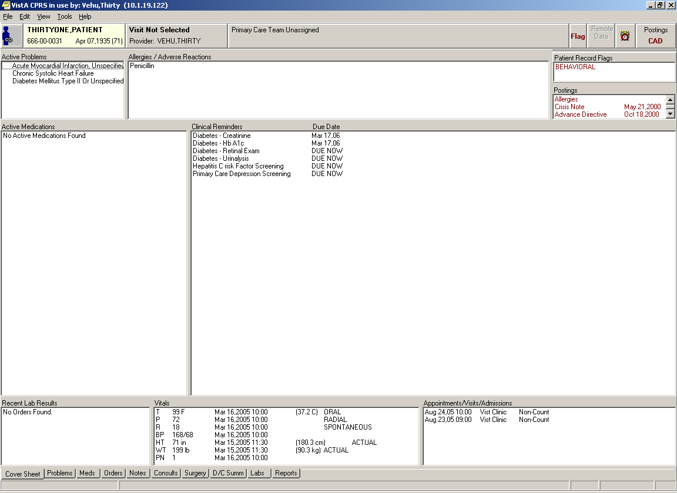
Data Retrieval: CPRS

Slide 13
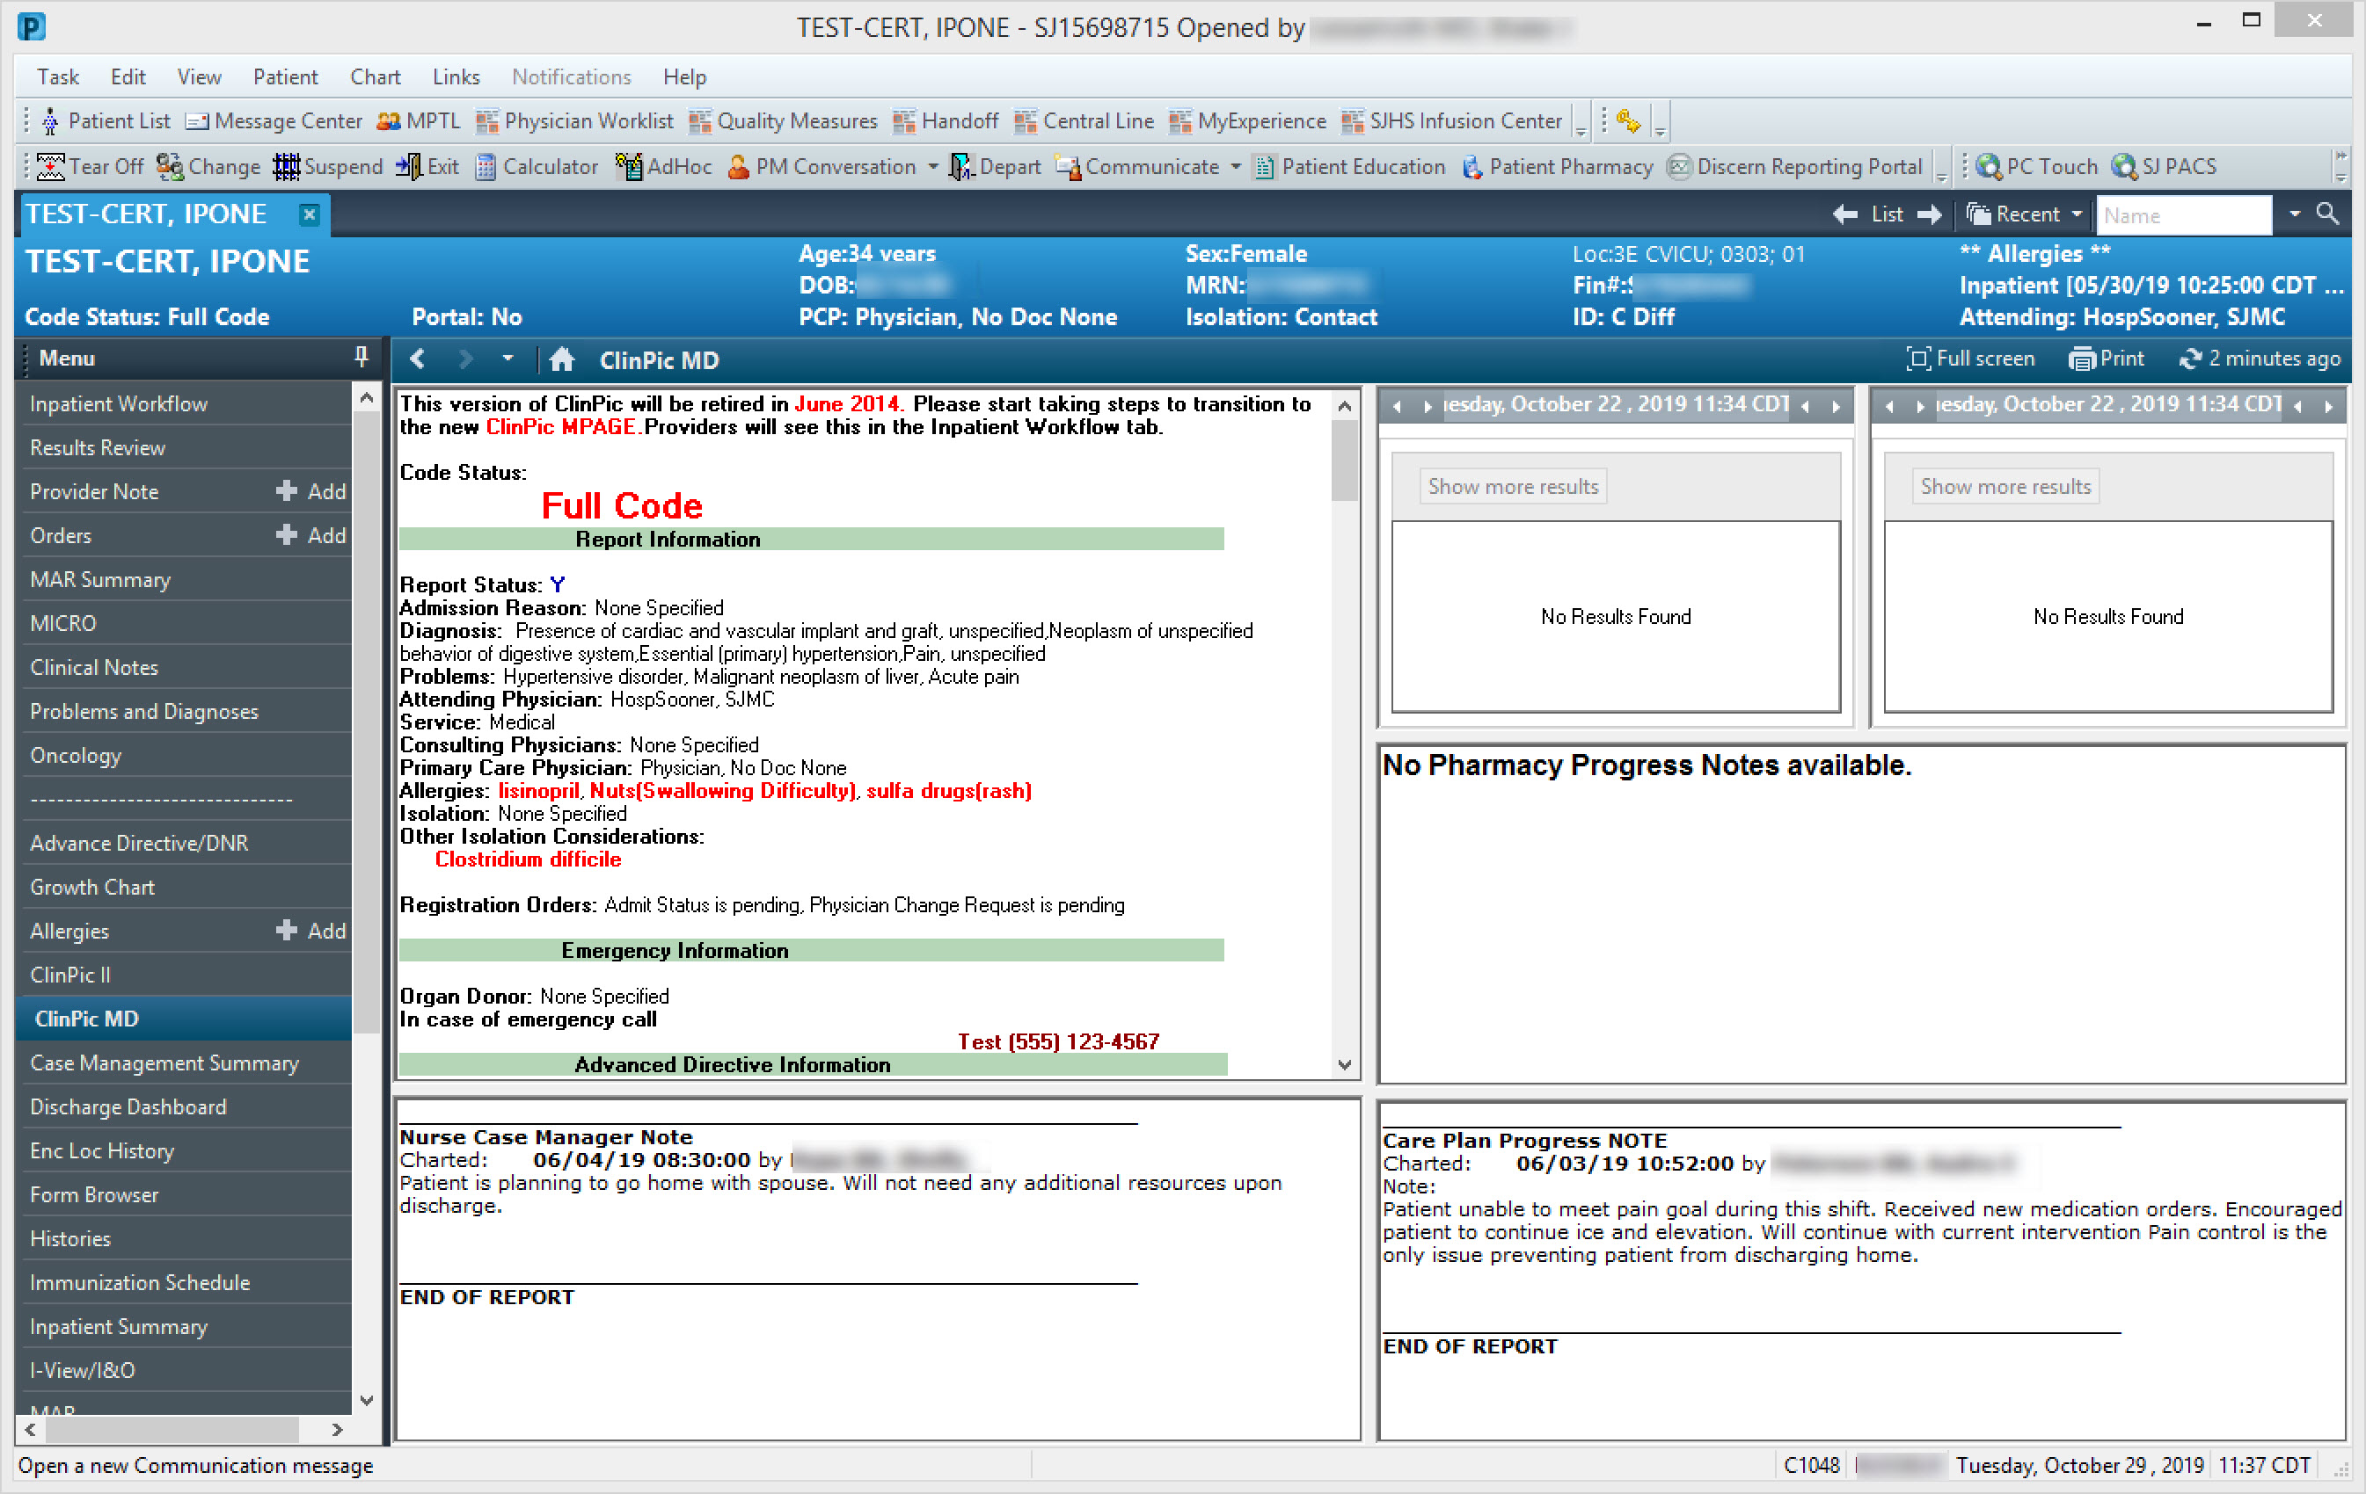
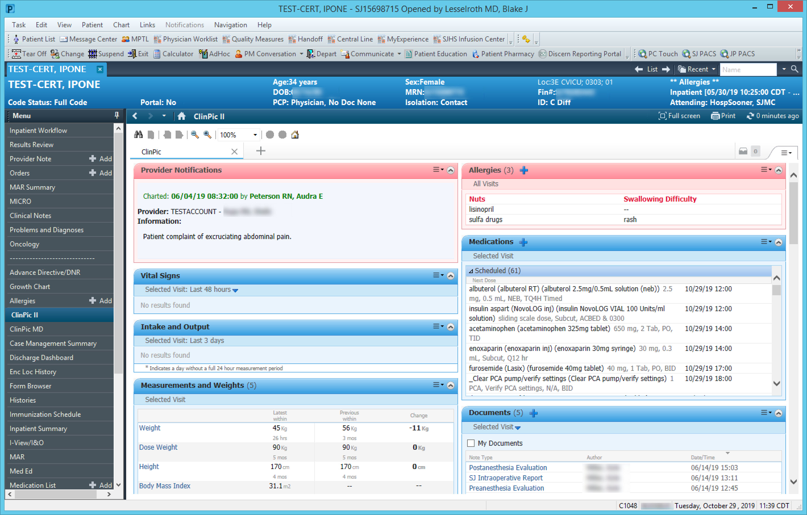
Data Retrieval: Cerner

Slide 14
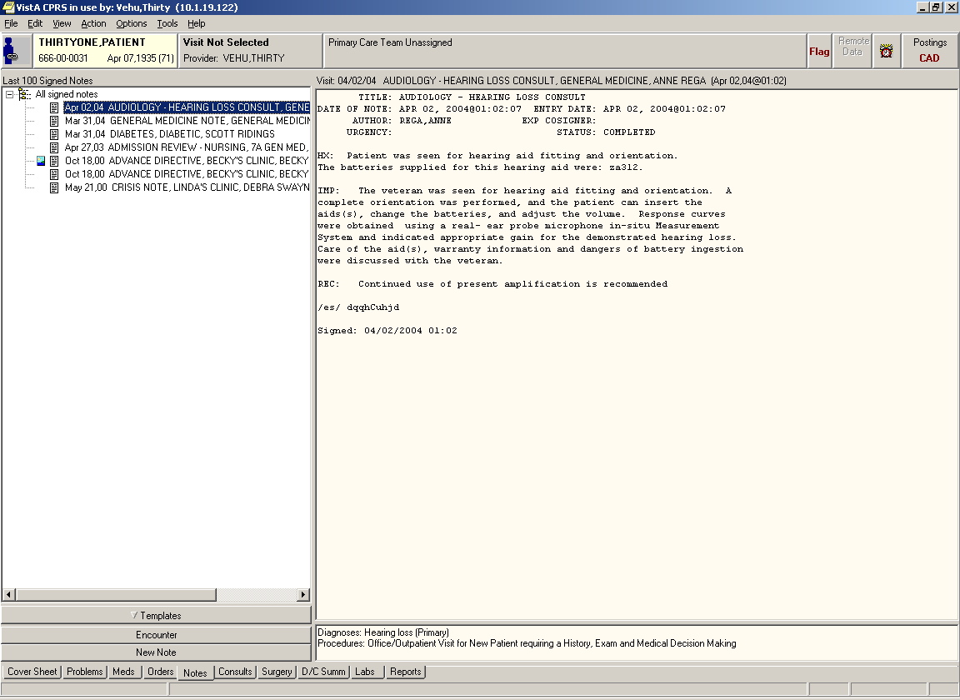
Clinical Documentation: CPRS

Slide 15
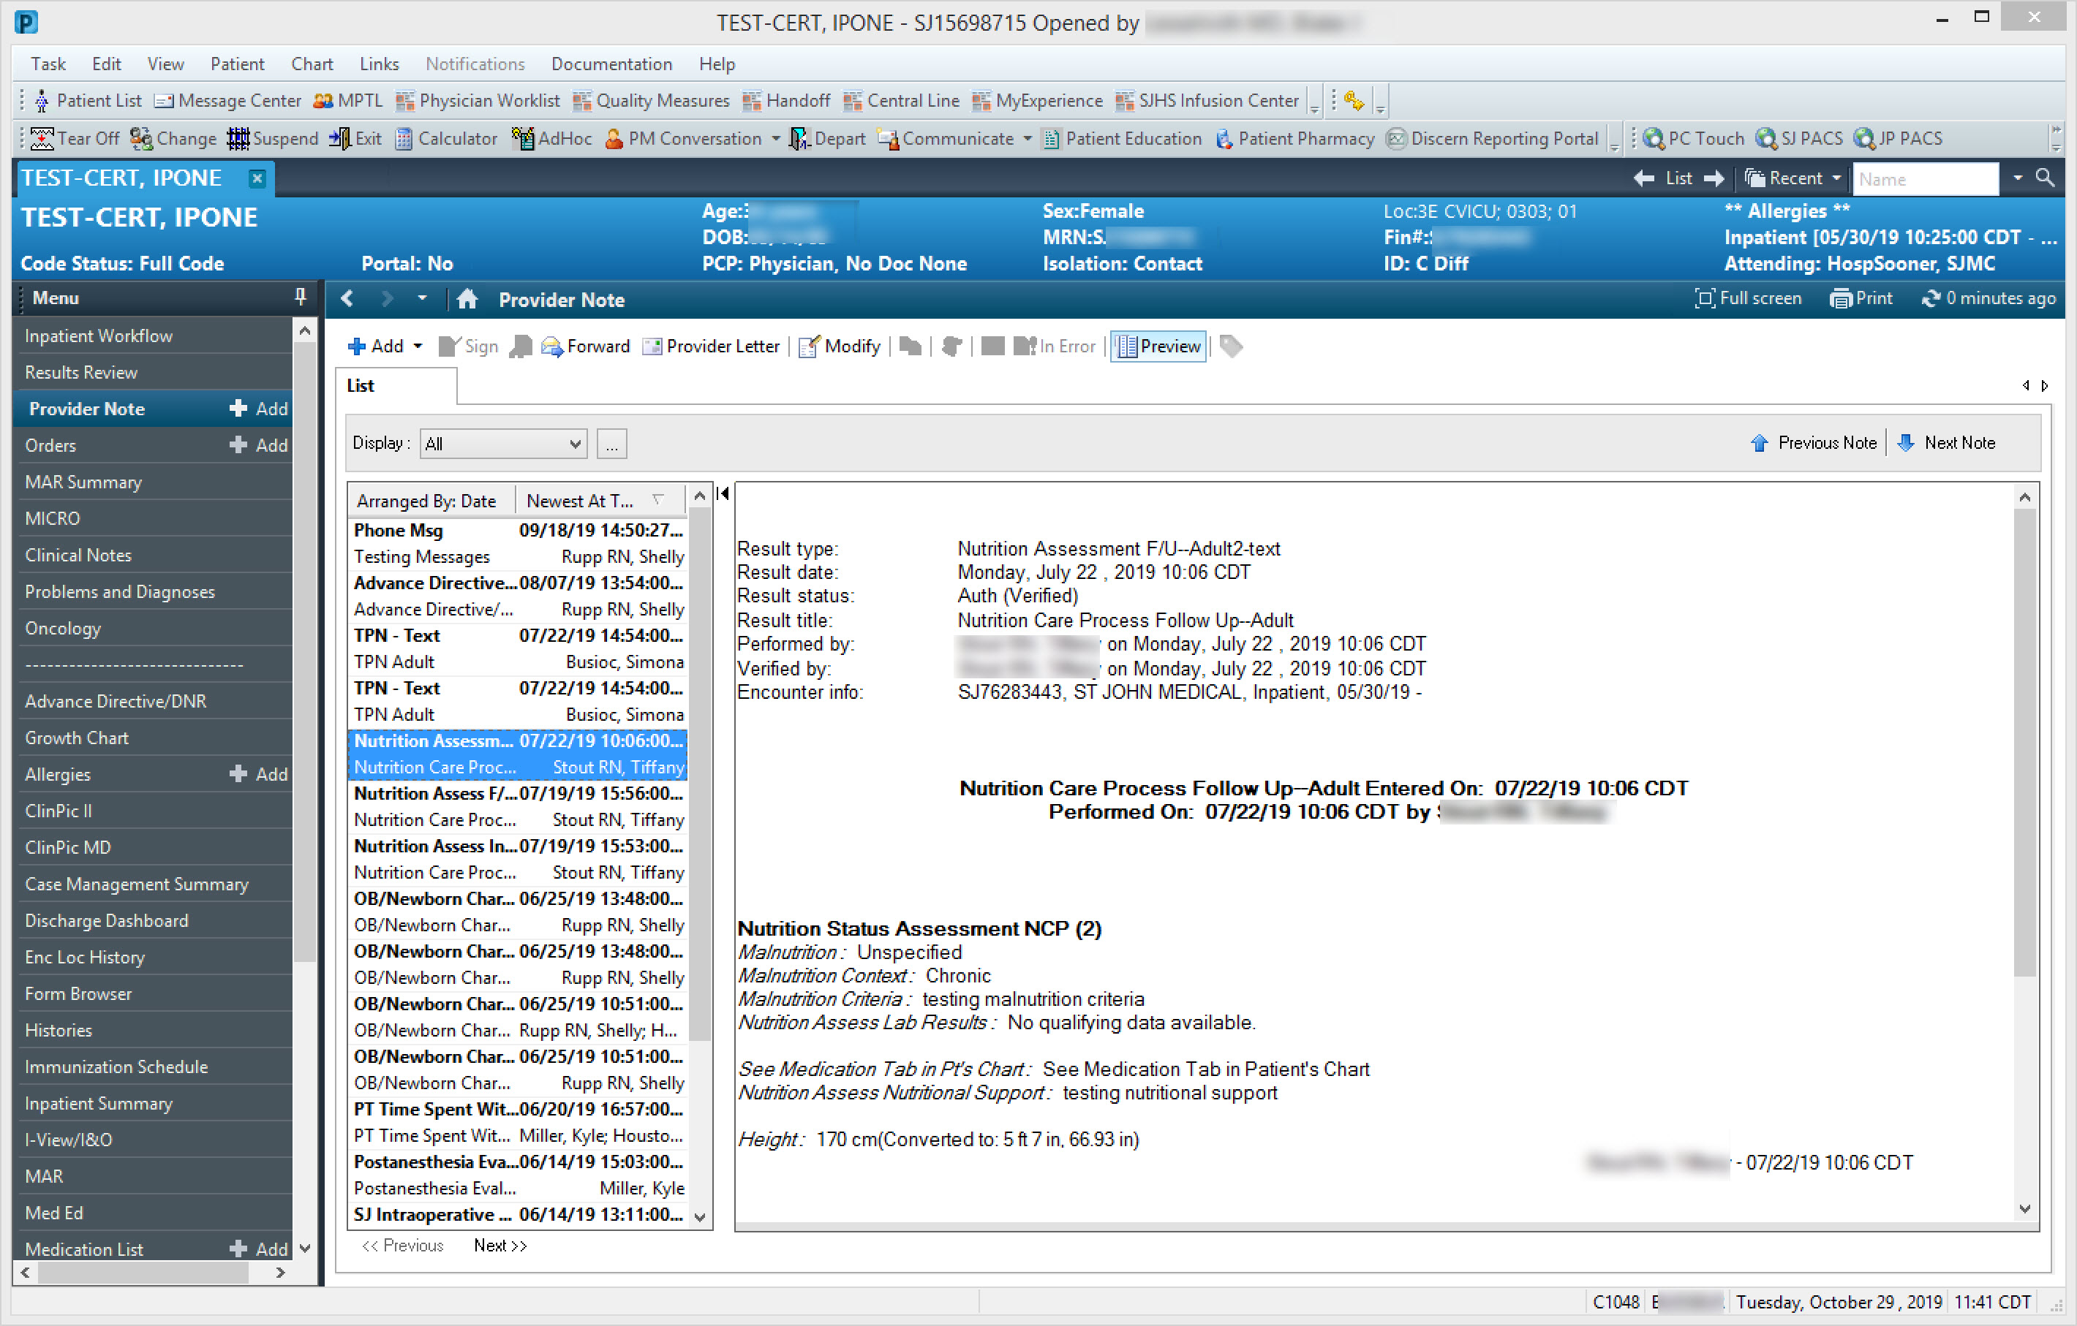
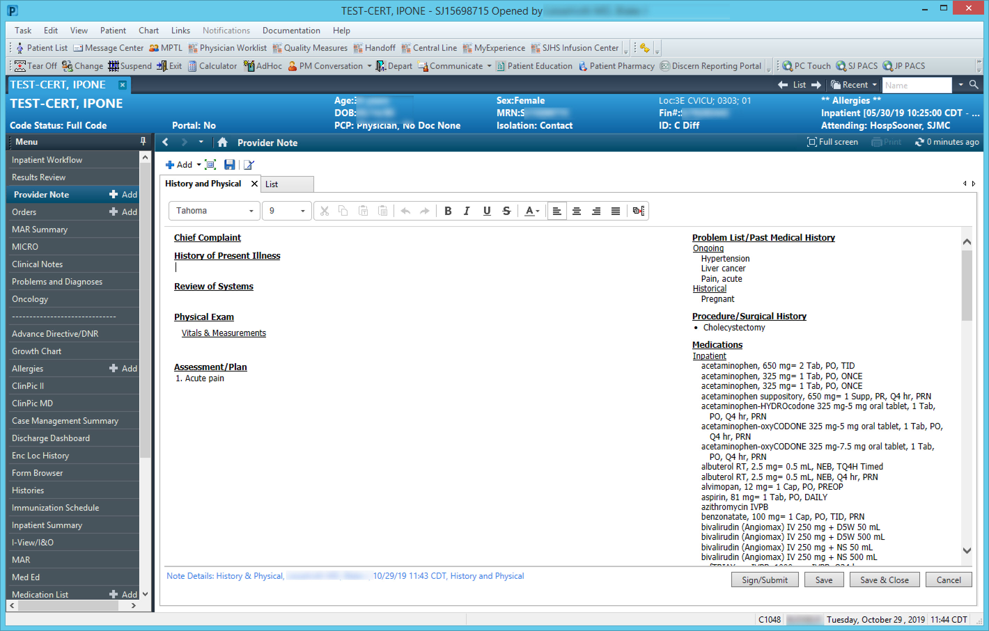
Clinical Documentation: Cerner

Slide 16
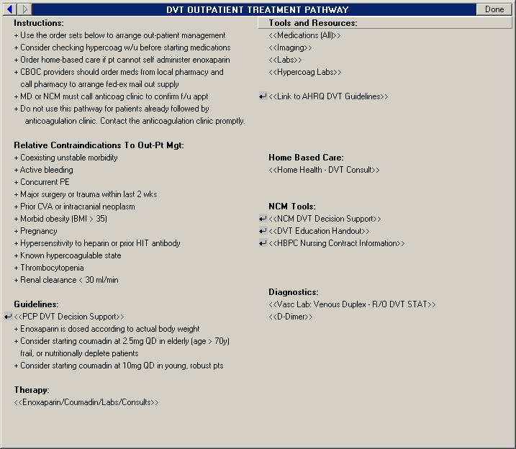
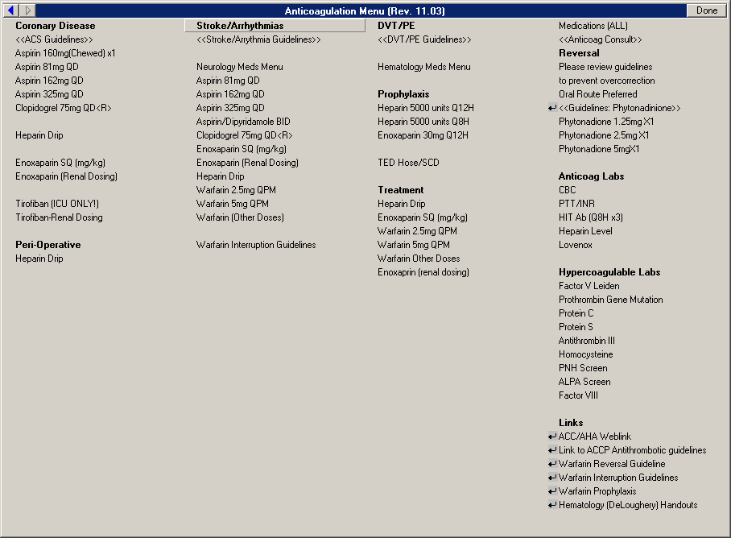
Order Entry Workflow: CPRS

Slide 17
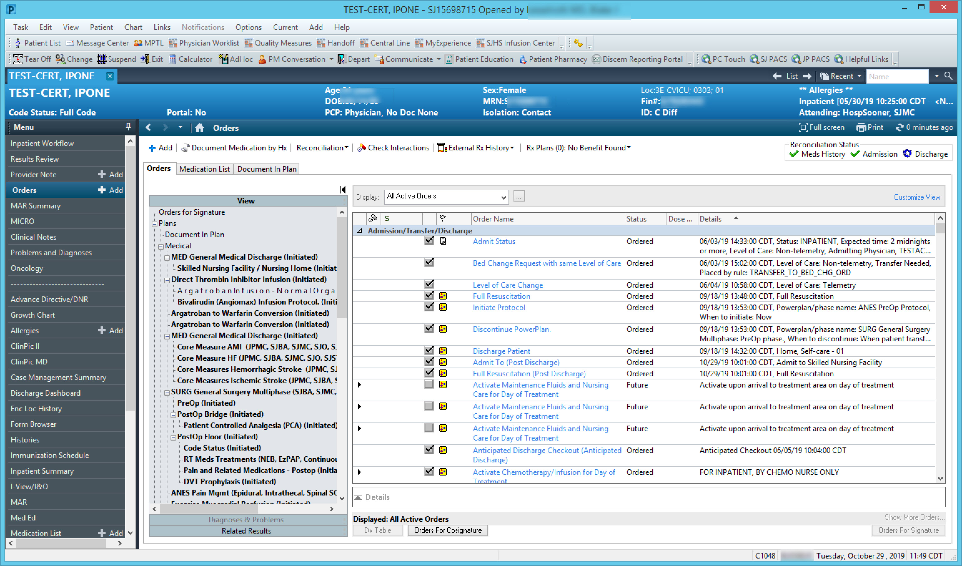
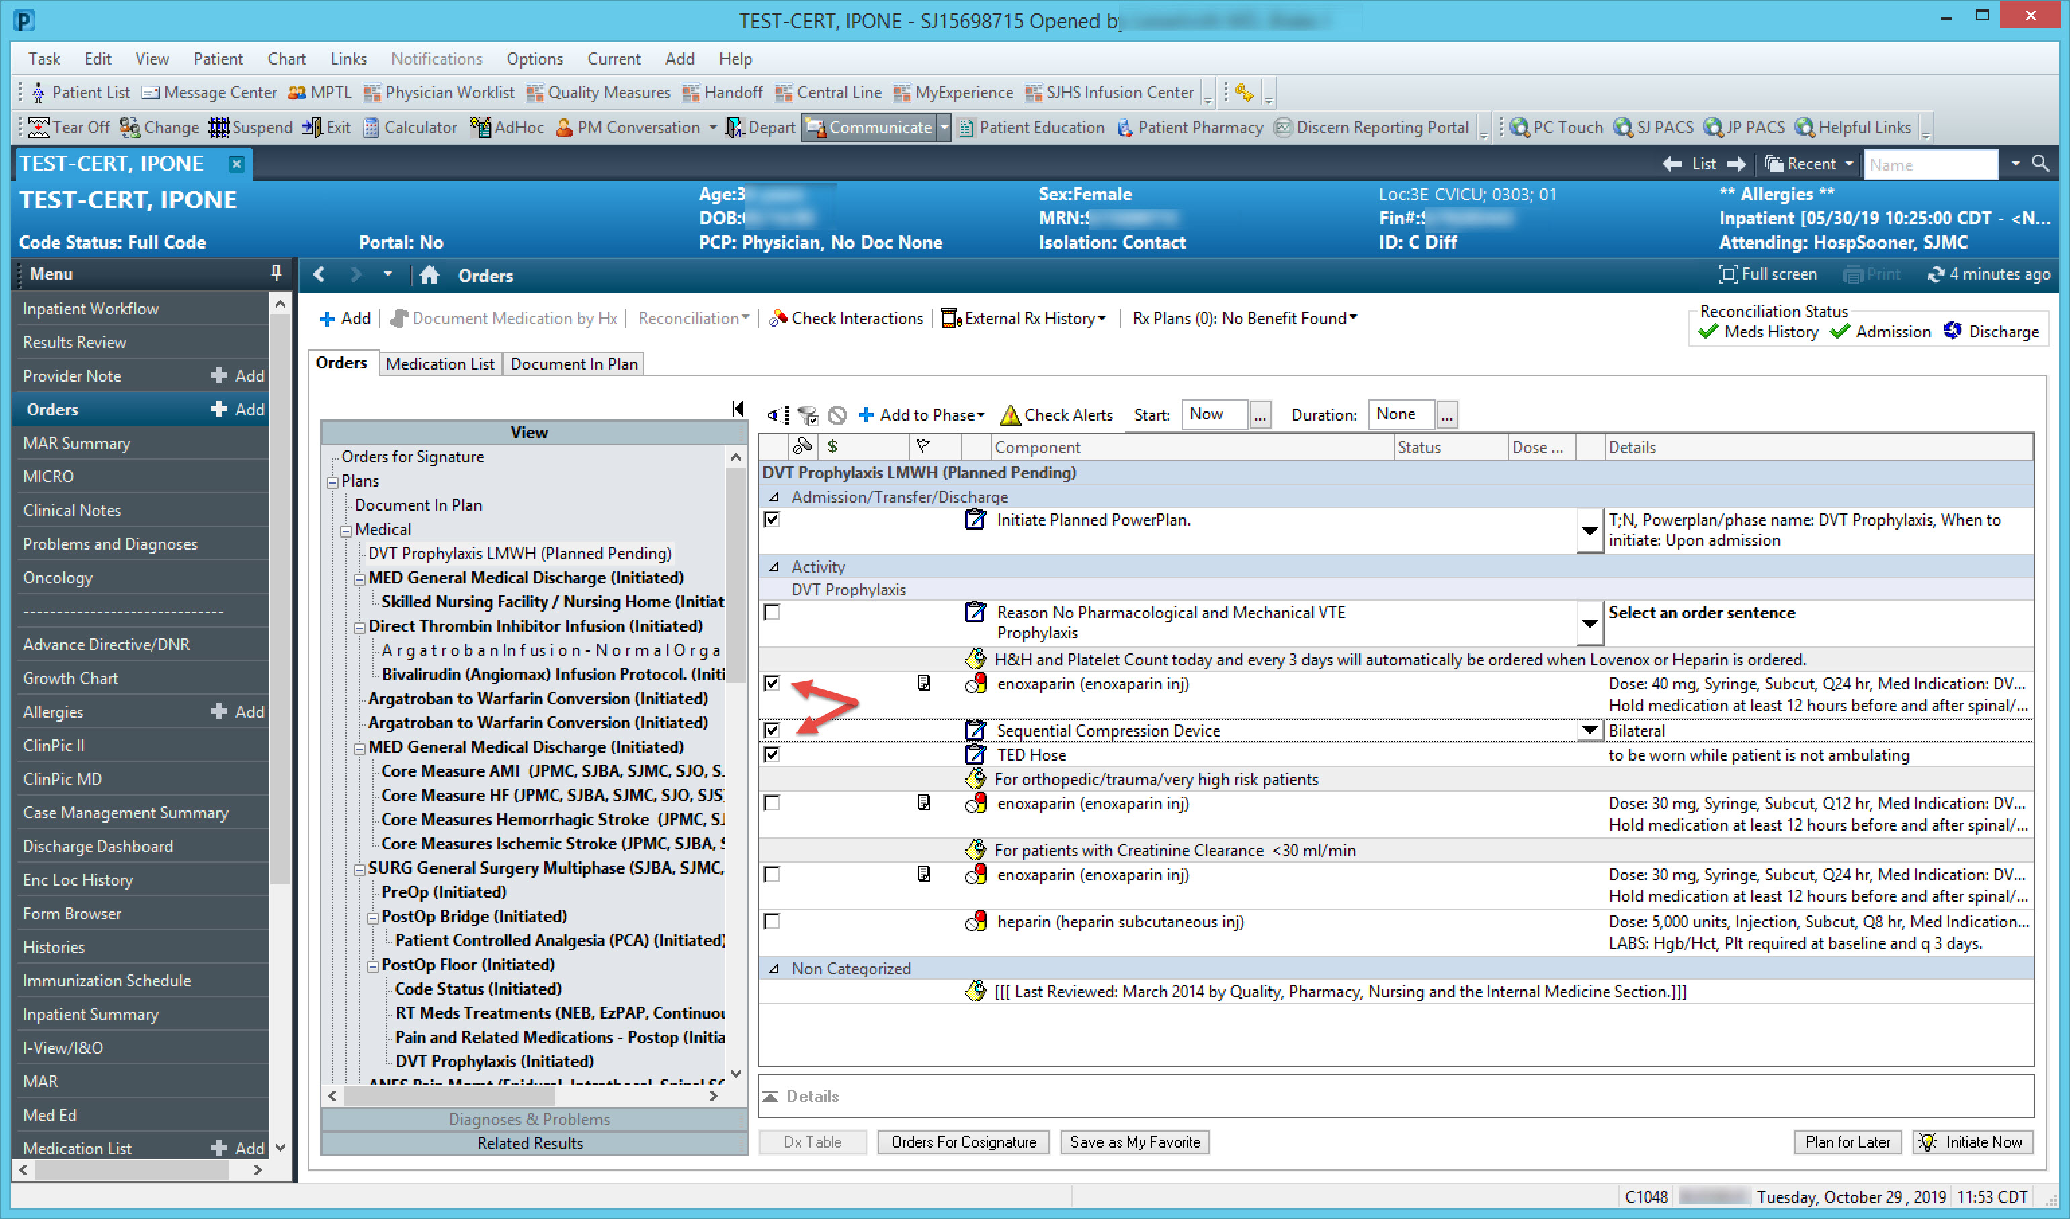
Order Entry Workflow: Cerner

Slide 18
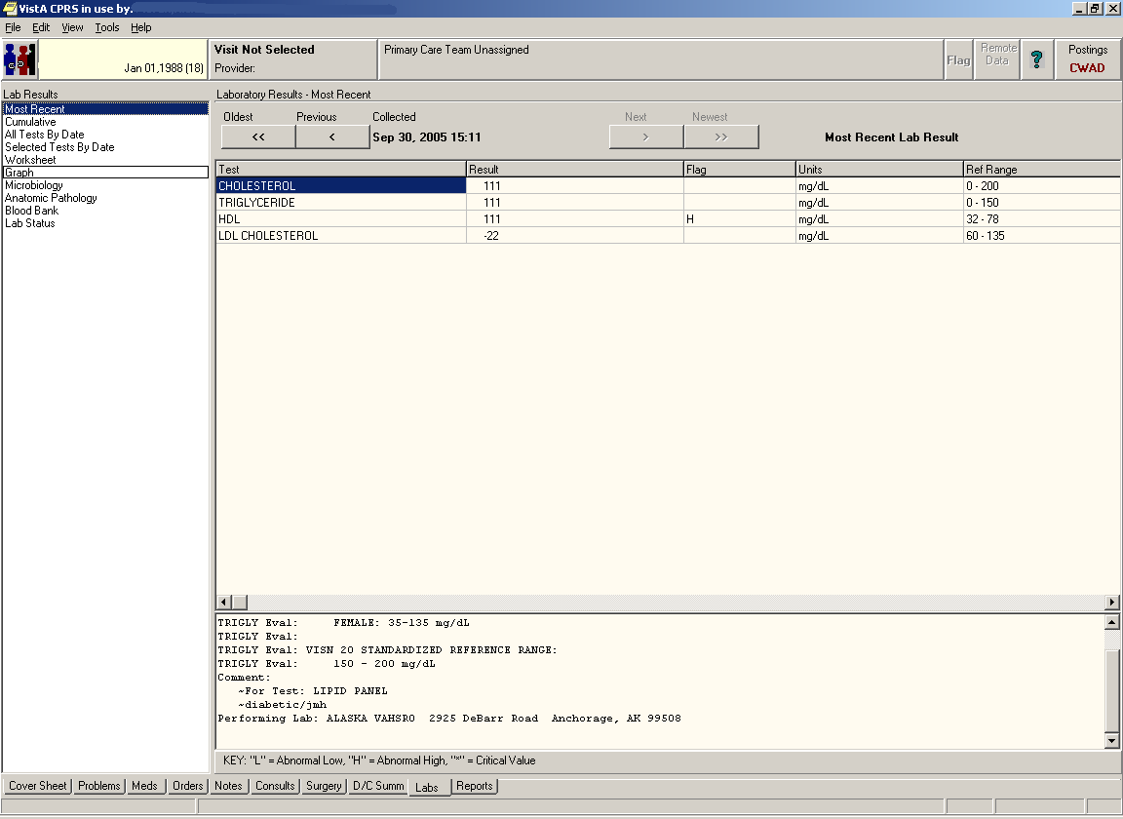
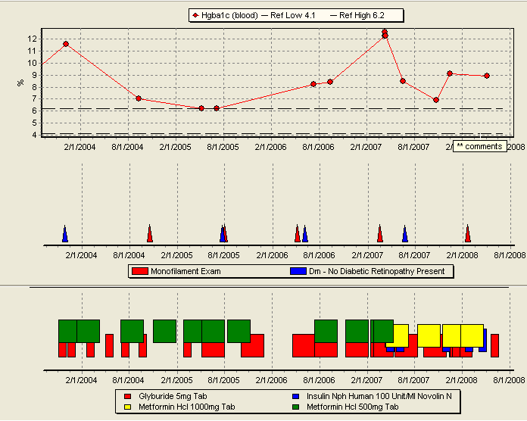
Results Reporting: CPRS

Slide 19
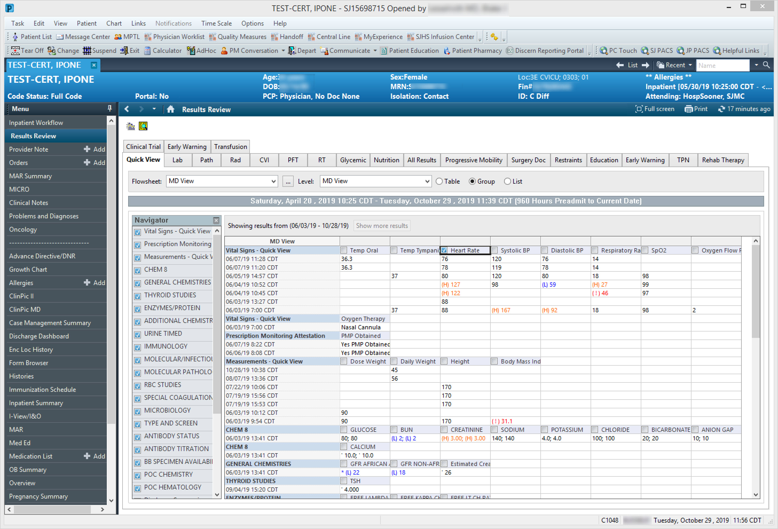
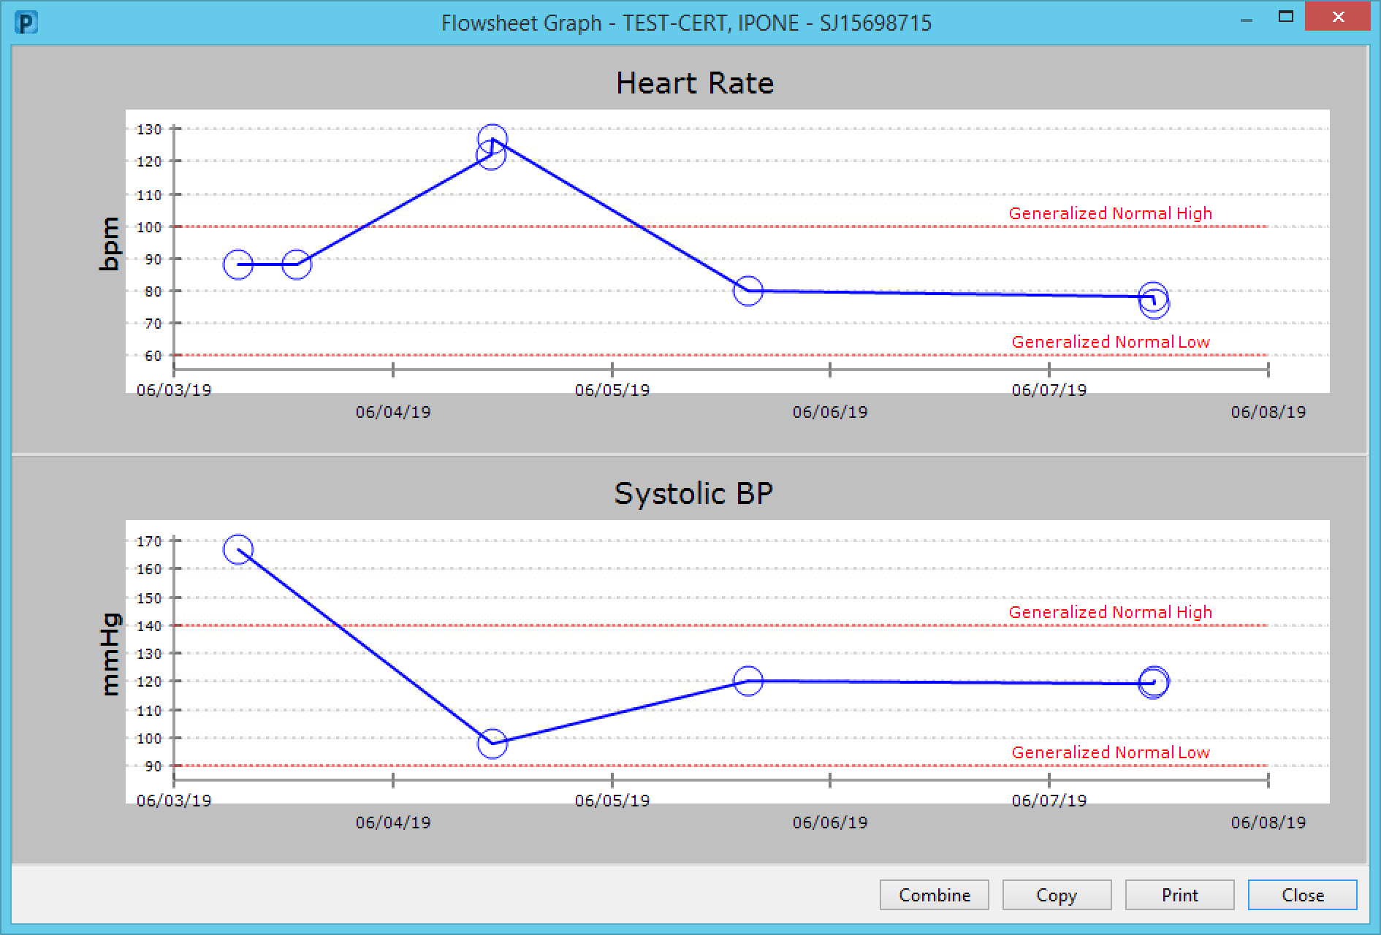
Results Reporting: Cerner

Slide 20
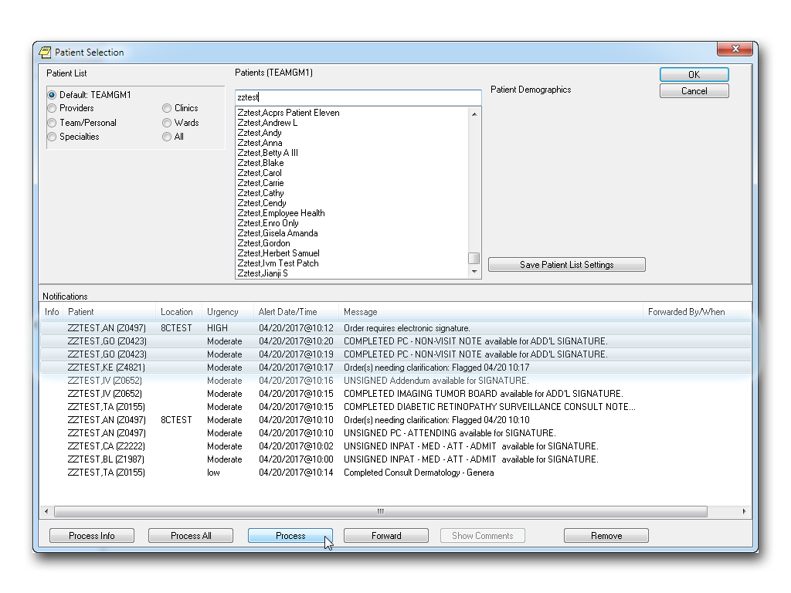
Interdepartmental Communication: CPRS

Slide 21
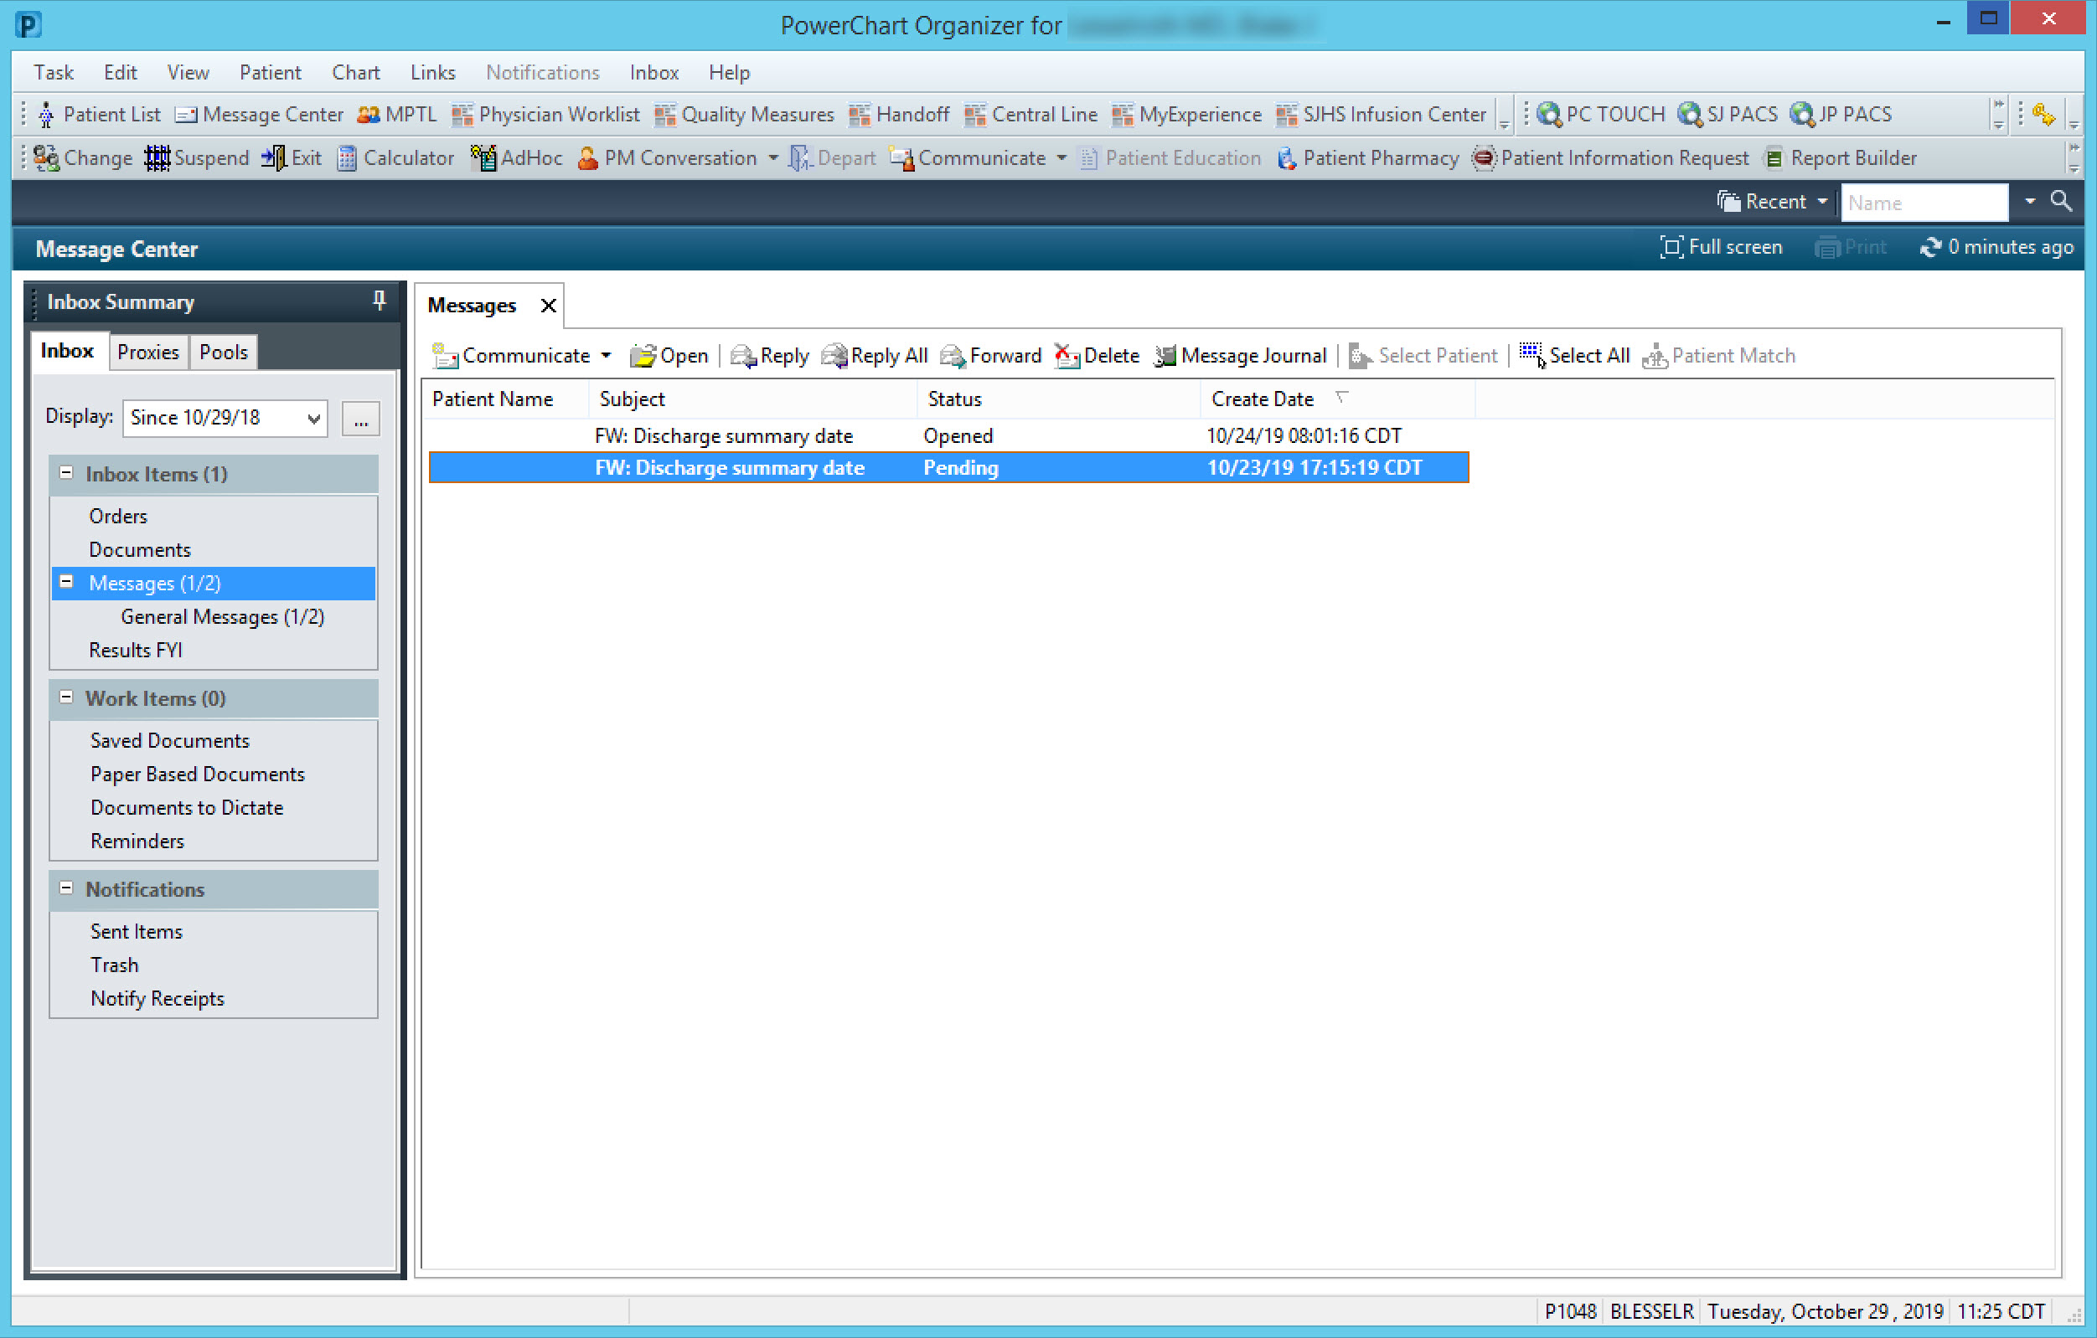
Interdepartmental Communication: Cerner

Slide 22
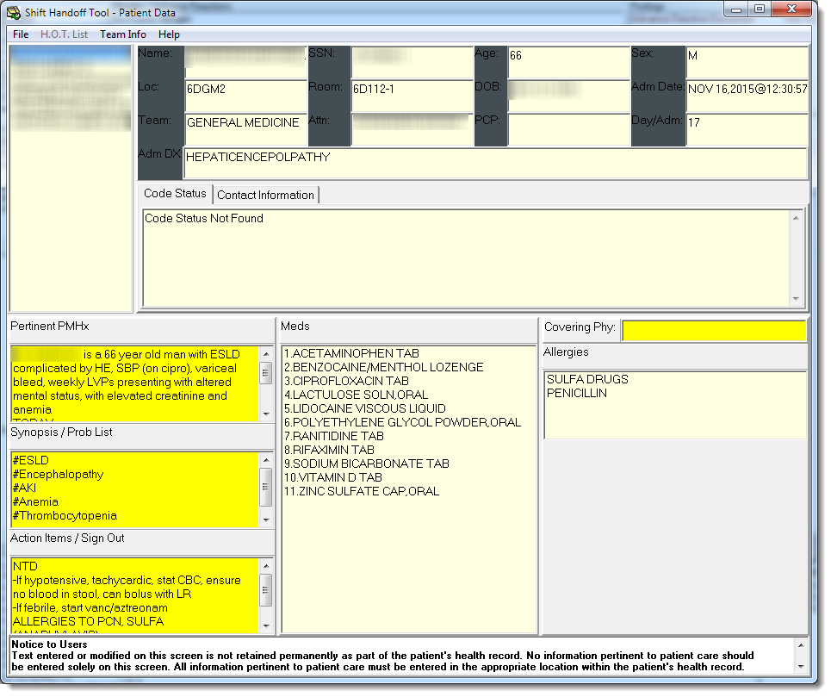
Shift Handoffs: VA Shift Handoff Tool

Slide 23
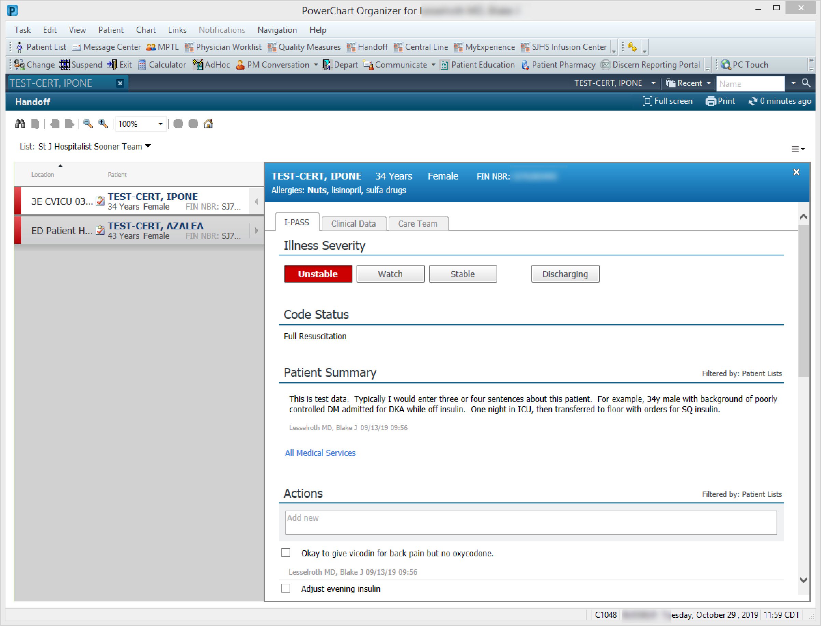
Shift Handoffs: Cerner IPASS

Slide 24
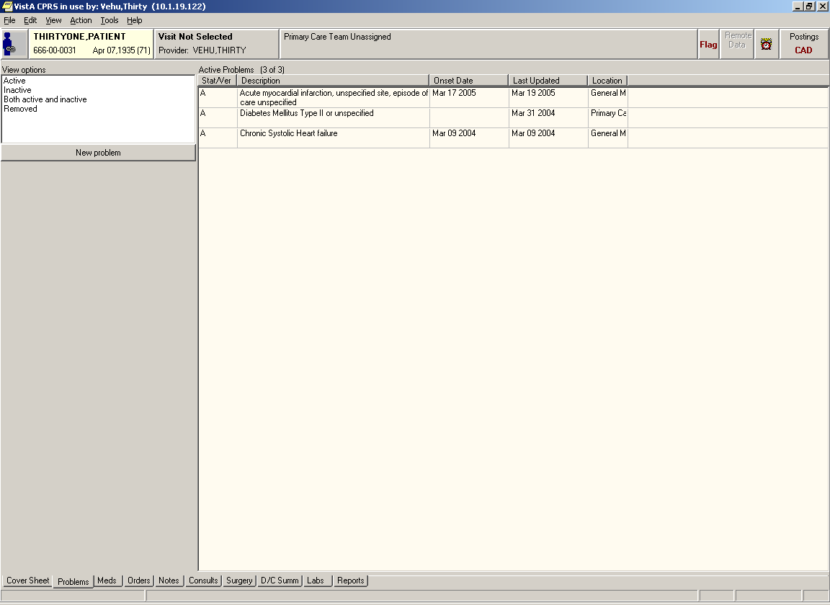
Coding and Billing: CPRS

Slide 25
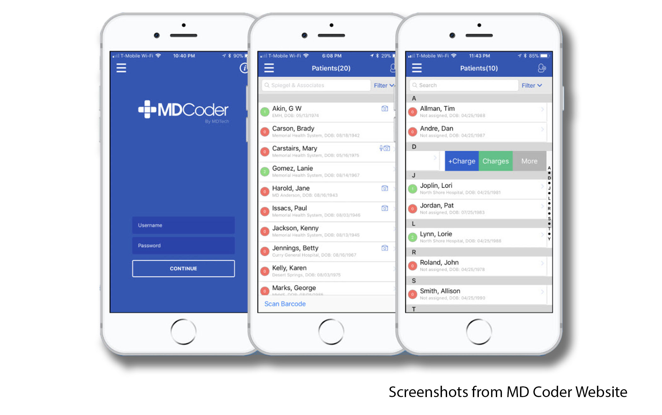
Coding and Billing: Cerner

Slide 26
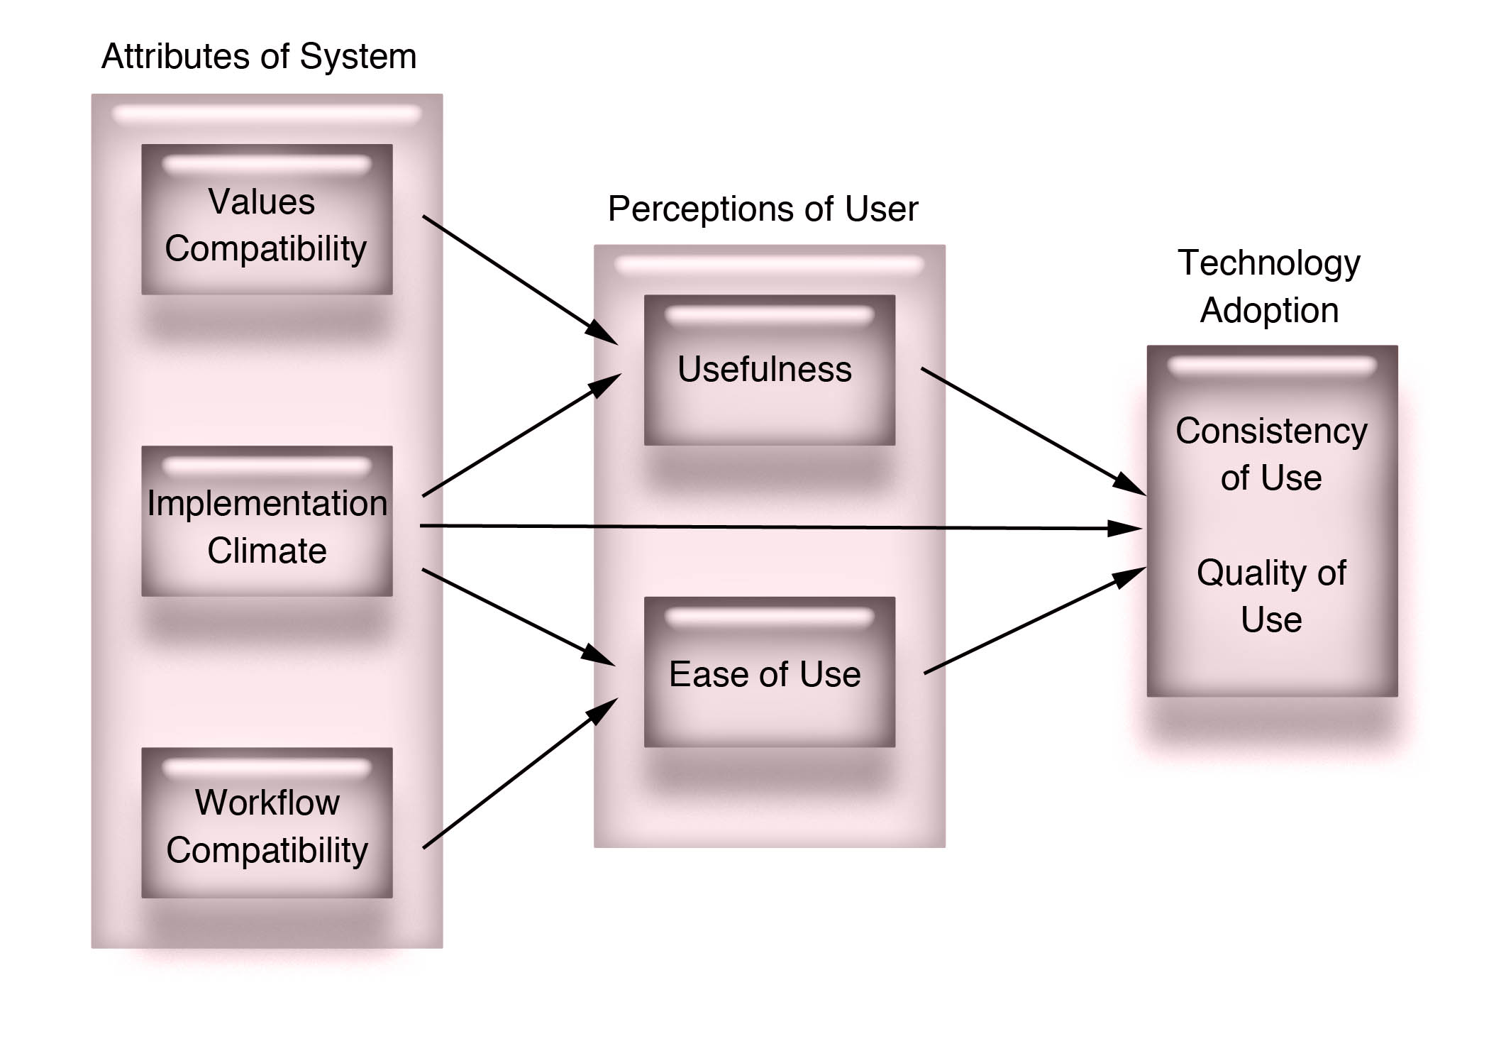
Implementation Considerations
Lesselroth, Info Prim Care, 2013
Holahan, JAMIA, 2014

Slide 27

Implementation Considerations
Physician resistance – need for clinical champions
Loss of productivity – will need to decrease volume and workload
Workflow changes – requires significant re-engineering
Physician patient interactions – patient-facing tools
Quality reporting issues – need warehouse and analysts
System integration and interoperability – academic partners
Usability issues – user-centered design paradigm

Slide 28
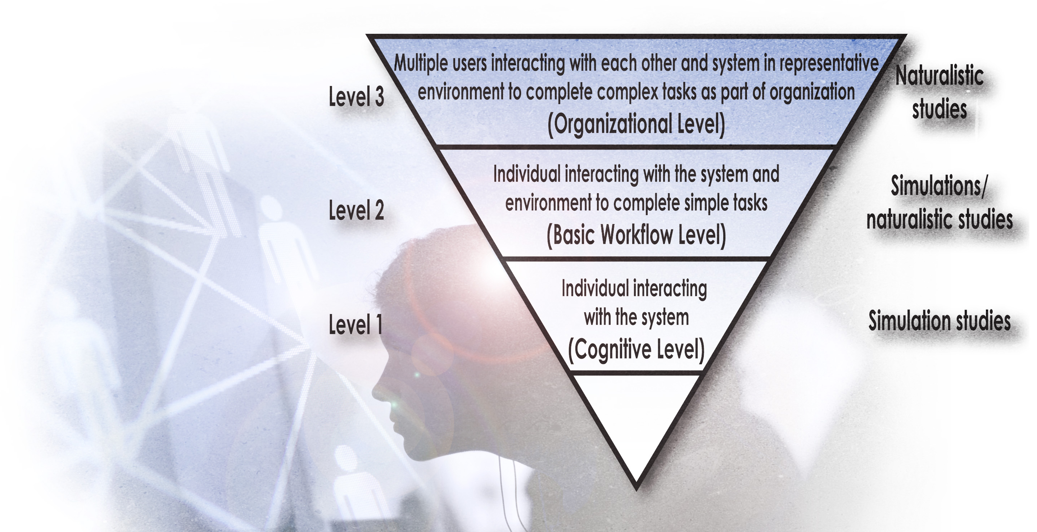
The Continuum of UX Testing

Slide 29

Thank You!
Blake-Lesselroth@ouhsc.edu
Victoria, BC, Canada

